Slide 1
Last Week
This Week
가족여행(8/12 – 8/16)
Lumerical FDTD 추가 구매 견적
CPU Workstation 구매 사양
Neural Network Model Training
8/20(화) 삼성전략산학 교류회
FDTD, New workstation 구매 진행
Neural Network Model preparation
Inverse Design coding

Slide 2
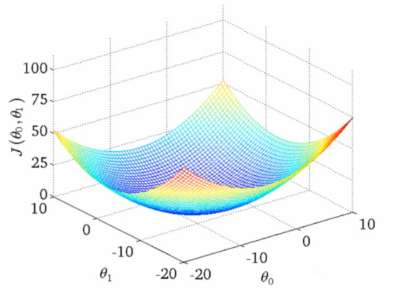
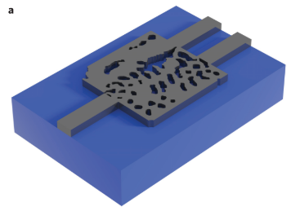







Inverse Design Process
FDTD
$x_{A}$
$$f\left(x\right)$$
$$y_{A}$$
$${FOM}_{A}$$
structure
spectrum
minimize
Cost function
$$\frac{1}{FOM_{A}}, Const.−FOM_{A}$$
Minimize by gradient descent algorithm
Gradient
$$Cost$$
$x_{A, ij}$
A. Y. Piggott et al., Nature Photonics, vol. 9, no. 6, pp. 374–377, Nov. 2015.

Slide 3
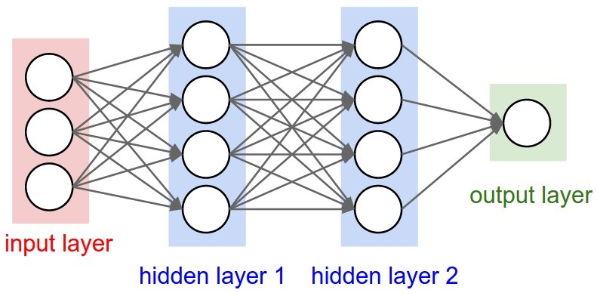




Inverse Design Process
Learning
Neural
Network
$x_{A}$
$$f\left(x\right)$$
$$y_{A}$$
$${FOM}_{A}$$
structure
spectrum
minimize

Slide 4
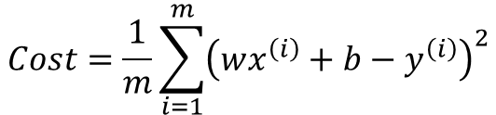


Inverse Design Process
bias
Perceptrons (1957)
b
Training Data
x | y
1 | 2
2 | 3
3 | 4
x
1
2
3
Activation
function
y
2
3
4
weight
:
x
w
wx+b
y
$$Cost=\frac{1}{m}\sum_{i=1}^{m}{{\left(wx^{\left(i\right)}+b−y^{\left(i\right)}\right)}^{2}}$$
Gradient
$$Cost$$
$$W$$
$$b$$

Slide 5
Inverse Design Process
bias
Perceptrons (1957)
b
Training Data
x | y
1 | 2
2 | 3
3 | 4
x
1
2
3
Activation
function
y
2
3
4
weight
:
x
w
wx+b
y
b = 1
w = 1
bias
1
Activation
function
x
4
weight
y
5
x
1
wx+b
y

Slide 6
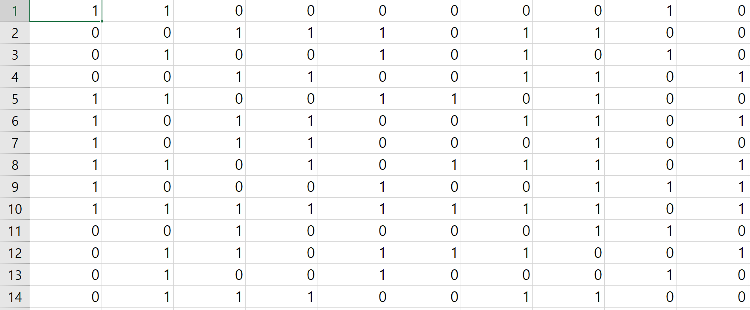
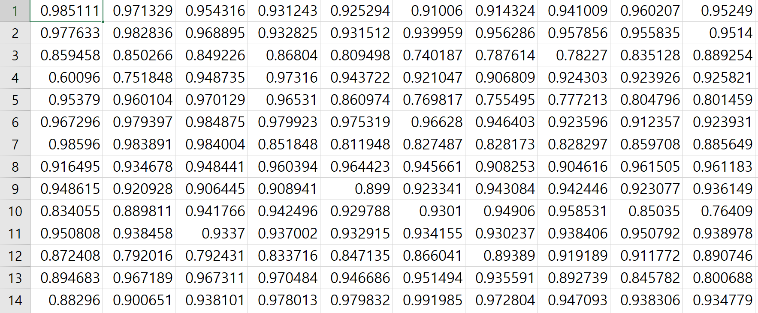




Inverse Design Process
Multi-Layer Perceptrons (MLP)
structures
spectrum
Neural
Network
$x_{A}$
$$f\left(x\right)$$
$$y_{A}$$
$${FOM}_{A}$$
structure
spectrum
minimize

Slide 7
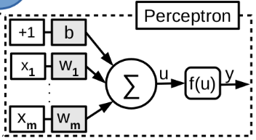
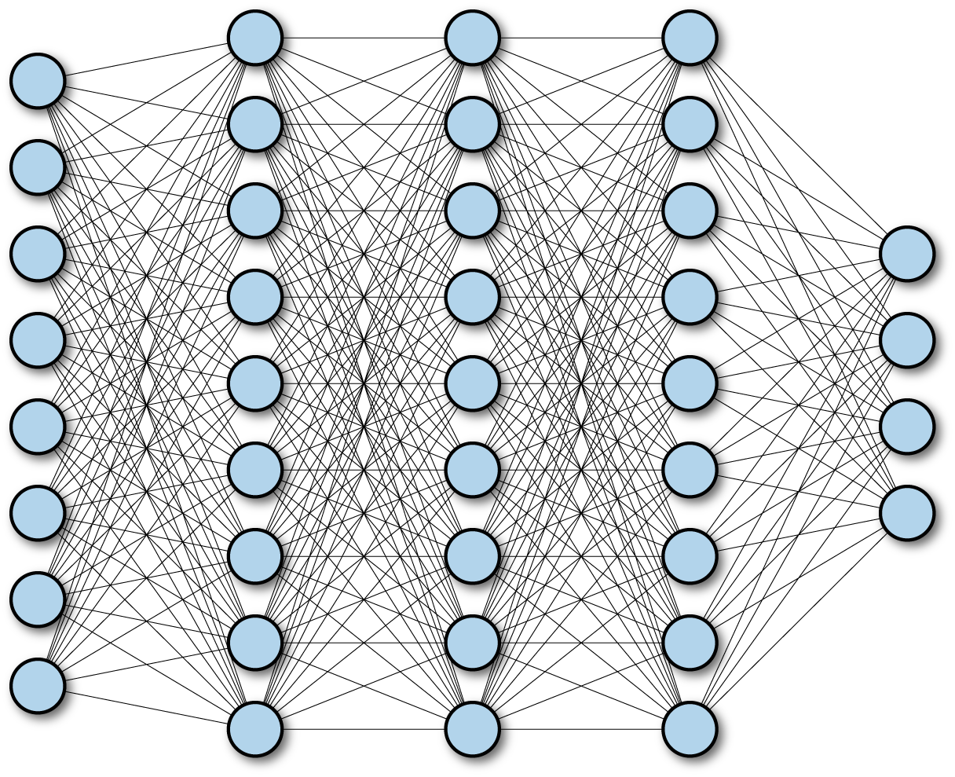
Neural Netowrk
FCNN (Fully Connected Neural Network)
Layer
Input
Output
ResNet (Residual Network)
Layer
1
Layer
2
Layer
3
Layer
4
Input
+
+
Output

Slide 8
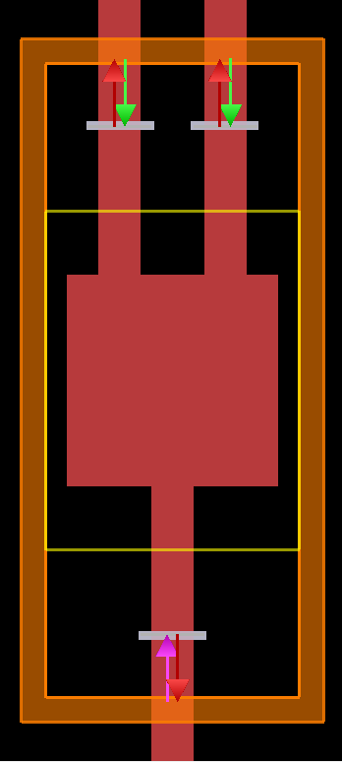
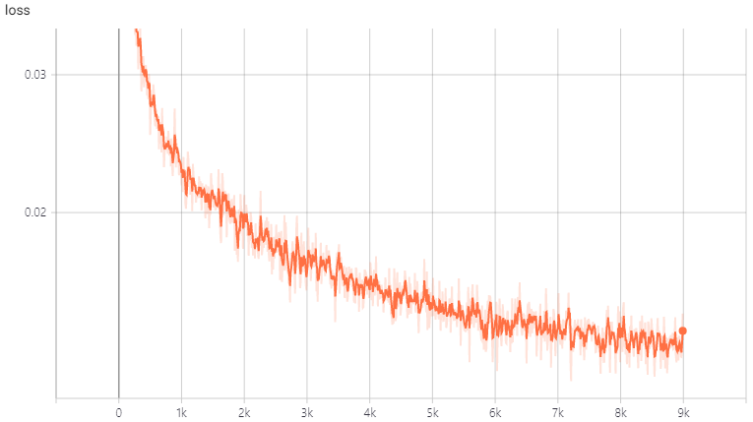
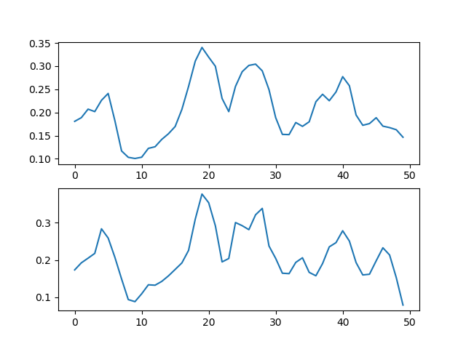
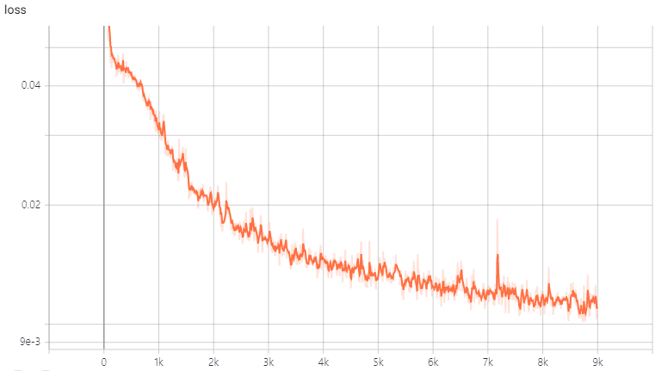
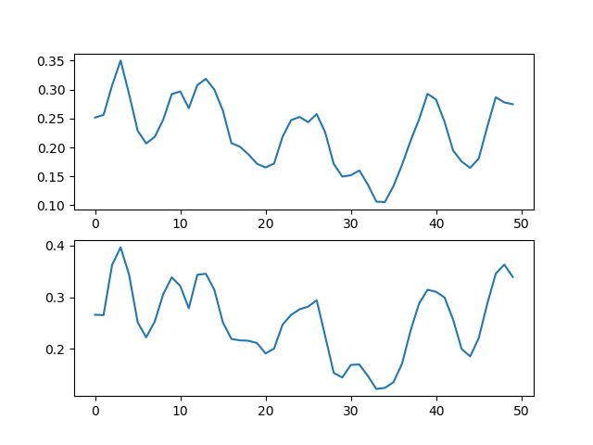


Training Result
$$f\left(x\right)=g\left(x\right)+l(x)$$
FDTD
Neural
Network
loss
$$loss= \left|f\left(x\right)−g\left(x\right)\right|$$
FCNN
Neural Network
Transmission
FDTD
~ 0.015
ResNet
Learning Step
Wavelength
Neural Network
Transmission
~ 0.010
FDTD
Learning Step
Wavelength

Slide 9
Paper Topic
1 x 2 Splitter
ResNet ref. : Mohammd H. Tahersima et al. “Deep Neural Network Inverse Design of Integrated Photonic Power Splitters,” Scientific Reports, 2019.02
CNN ref.: Mohammd H. Tahersima et al. “Nanostructured Photonic Power Splitter Design via Convolutional Neural Networks, ” in Conference on Lasers and Electro-Optics, OSA, 2019.05
1 x 3 Splitter
ML ref. : Alexander Y. Piggott et al. “Fabrication-constrained Nanophotonic inverse design,” Scientific Reports, 2017.05
Dr. Philsophy: Alexander Y. Piggott , “Automated Design of Photonic Devices,” 2018.06

